Slide 1
Future of Gas Considerations

Slide 2
Racially Discriminatory Redlining

Slide 3
Child Asthma

Slide 4
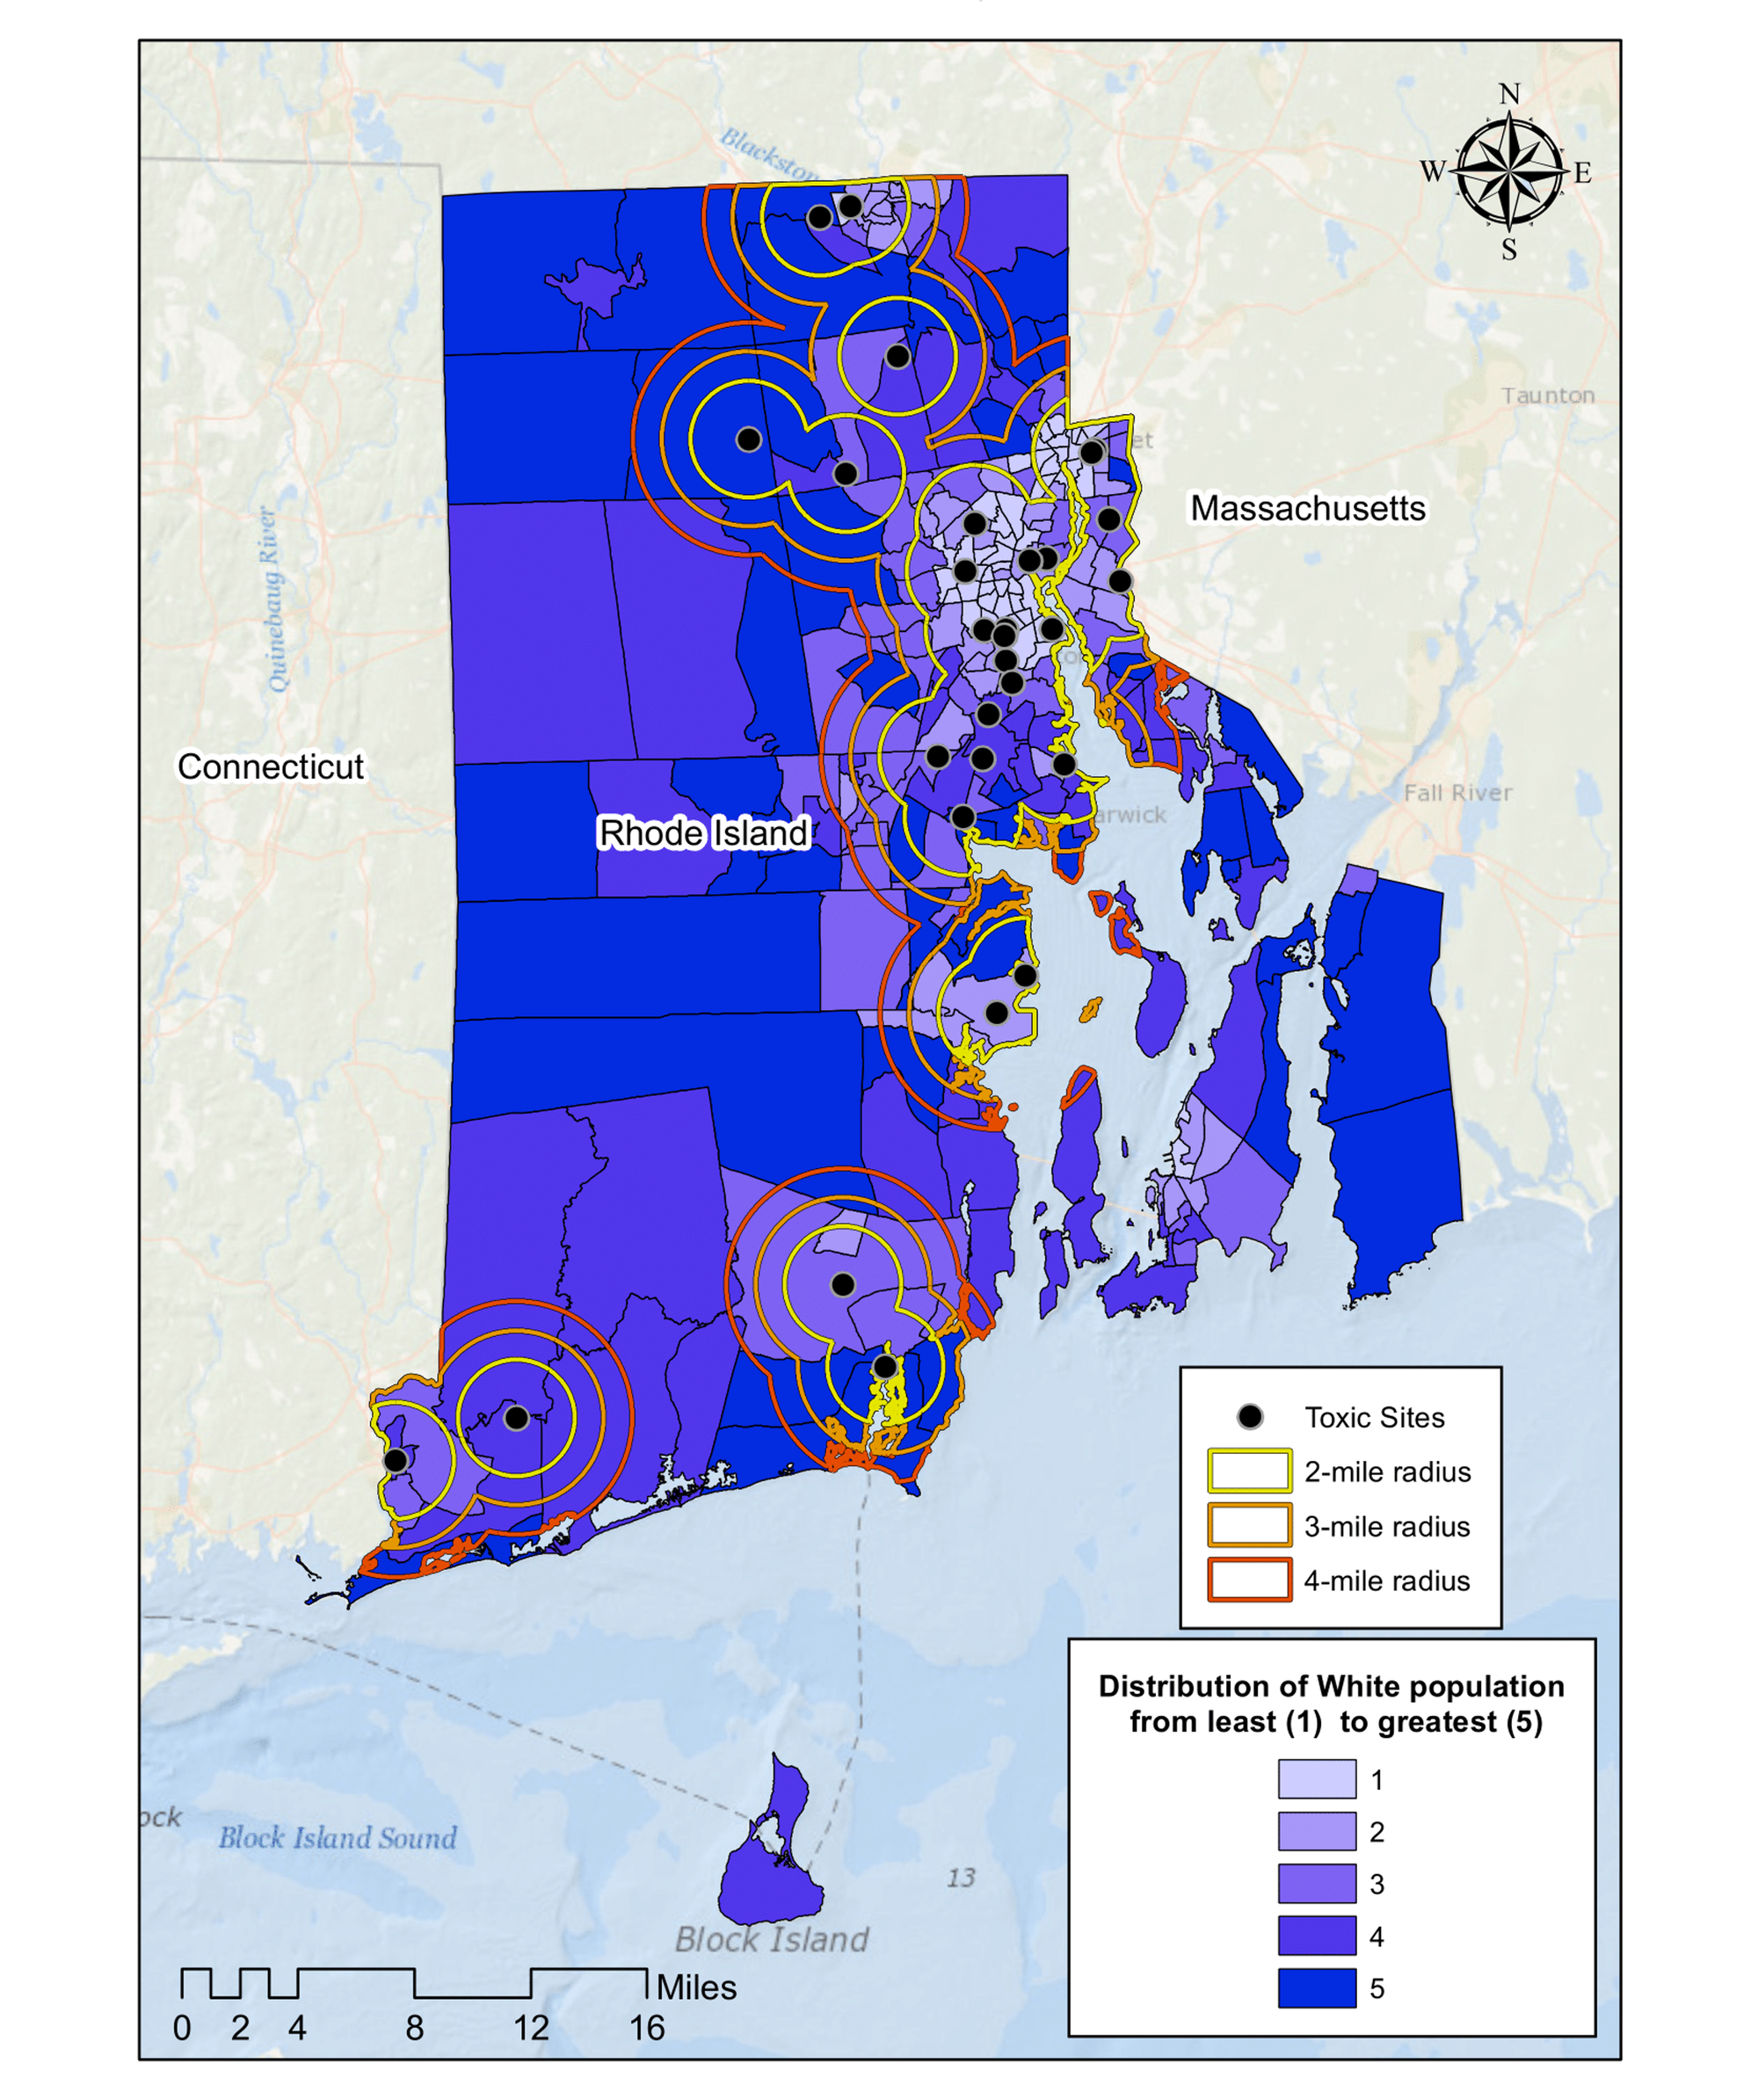
Toxic Waste Sites and Race

Slide 5
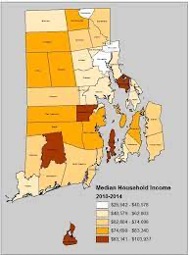
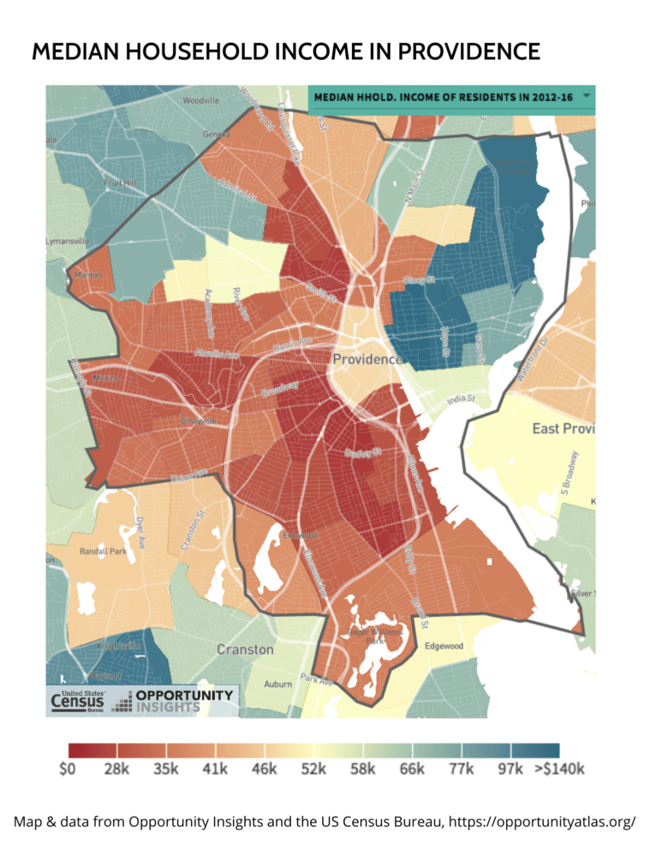
Household Income

Slide 6
Lead Poisoning, Asthma, Income & Older Housing Combined

